Slide 1
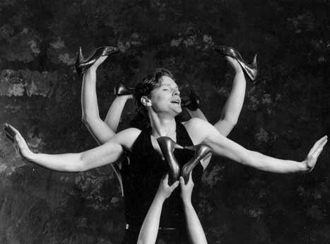
PHYSICAL THEATRE
Year 8 Drama
Lesson 1
Learning Skills & Techniques

Slide 2
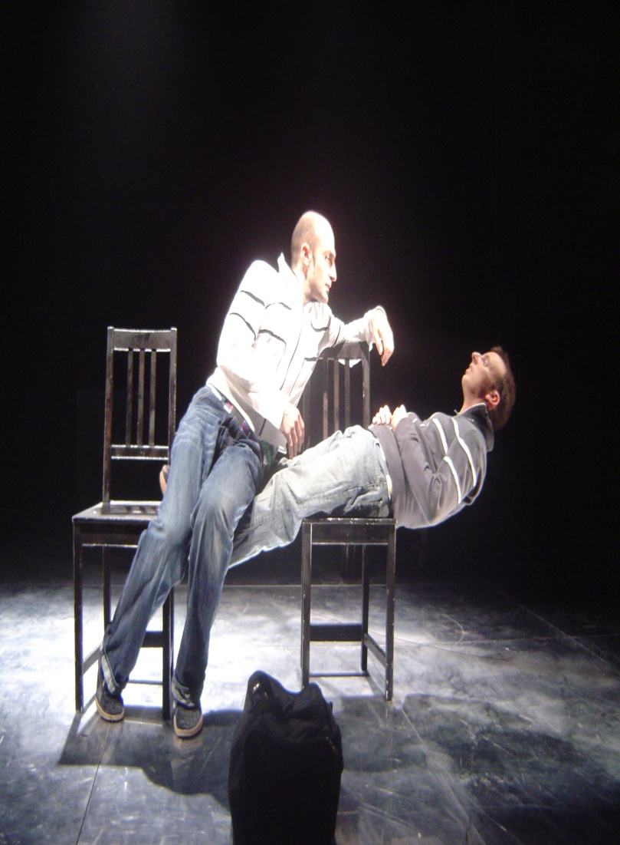
LESSON OBJECTIVE:
To understand the skills needed to create effective physical theatre

Slide 3
KEYWORDS
Physical theatre
Body tension
Control
Strength
Mime
Focus
Ensemble
Trust

Slide 4
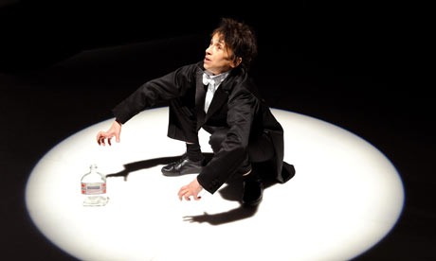
What is Physical Theatre?
Lesson Objective:
To understand the skills needed to create effective physical theatre
To understand how to perform a piece of physical theatre.
10 Seconds Thinking Time
Get into pairs
Label yourselves A & B
Teacher decides who will start
Timed Pair Share
Teacher will ask students to share their ideas or their partners ideas.

Slide 5
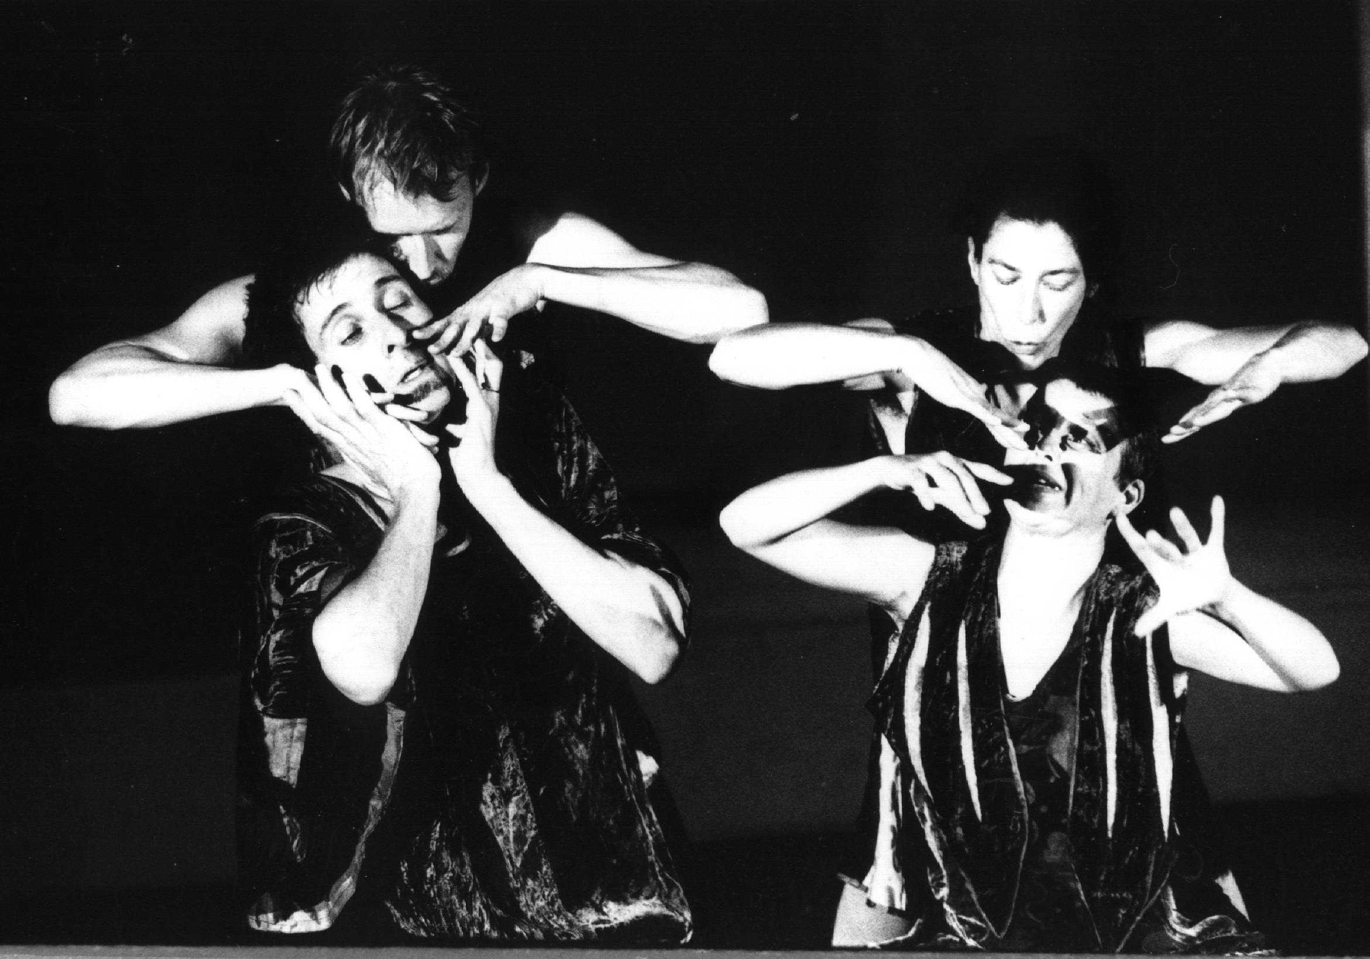
What is Physical Theatre?
Lesson Objective:
To understand the skills needed to create effective physical theatre
To understand how to perform a piece of physical theatre.
USING YOUR BODY TO CREATE A PERFORMANCE THAT IS NON-NATURALISTIC.
YOUR BODIES HAVE TO BE EXAGGERATED

Slide 6
What is Physical Theatre?
Lesson Objective:
To understand the skills needed to create effective physical theatre
To understand how to perform a piece of physical theatre.
Physical Theatre shows that you don’t have to use words to express ideas.
It uses techniques such as movement, mime, gesture and dance.

Slide 7
TALK TALK VIDEO EXAMPLE
Lesson Objective:
To understand the skills needed to create effective physical theatre
To understand how to perform a piece of physical theatre.
https://www.youtube.com/watch?v=VcQIwbvGRKU&list=PLFA5E529BD03678BE&index=2

Slide 8
DV8 VIDEO EXAMPLE
Lesson Objective:
To understand the skills needed to create effective physical theatre
To understand how to perform a piece of physical theatre.
https://www.youtube.com/watch?v=NShJJr1ztkM

Slide 9
Formations
Lesson Objective:
To understand the skills needed to create effective physical theatre
To understand how to perform a piece of physical theatre.
Walk around the space.
The teacher will shout out a number.
You must get into groups of that number as quickly as possible.
The teacher will then shout out a shape or item, these will relate to the play.
You must make this shape or item with your group as quickly as possible.

Slide 10
What skills might be needed to make effective physical theatre?
Lesson Objective:
To understand the skills needed to create effective physical theatre
To understand how to perform a piece of physical theatre.
Tension
Physical Strength
Ensemble
Good ‘eye’ Contact
Trust
Focus
Movement
Control

Slide 11
Creating Letters
Lesson Objective:
To understand the skills needed to create effective physical theatre
To understand how to perform a piece of physical theatre.
Students pair up.
Working together as a pair, students have to create letters.
10 seconds to create each letter:
L
T
X
P

Slide 12
Creating Letters
Lesson Objective:
To understand the skills needed to create effective physical theatre
To understand how to perform a piece of physical theatre.
Students pair up.
Take it in turns to mould their partner into various letters using their whole body.
10 seconds to create each letter:
F
M
E
K

Slide 13
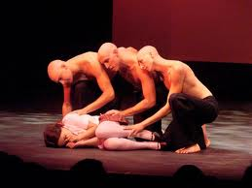
QUESTION
Lesson Objective:
To understand the skills needed to create effective physical theatre
To understand how to perform a piece of physical theatre.
How is the body used differently?

Slide 14
MESSAGES
Lesson Objective:
To understand the skills needed to create effective physical theatre
To understand how to perform a piece of physical theatre.
Split the class in half; each half has to write a message to the other half of the class, using only their bodies
Each half presents their message to the others.
What skills were needed for this task?

Slide 15
MAKING SHAPES
Lesson Objective:
To understand the skills needed to create effective physical theatre
To understand how to perform a piece of physical theatre.
TRIANGLE
Whole class has 30 seconds to create each shape that is called out by the teacher as if it were a birds eye view.
For this task you had to work as a what?
Ensemble.
SQUARE
STAR (5 Point)
UMBRELLA
DIAMOND

Slide 16
ACTION CIRCLE
Lesson Objective:
To understand the skills needed to create effective physical theatre
To understand how to perform a piece of physical theatre.
One student does an action & sound that is passed around the circle. As soon as the leader has finished first action and sound, they repeat a second so actions are continually rippling around the circle.

Slide 17
What skills did you use here?
Lesson Objective:
To understand the skills needed to create effective physical theatre
To understand how to perform a piece of physical theatre.
FOCUS

Slide 18

BALANCING
Lesson Objective:
To understand the skills needed to create effective physical theatre
To understand how to perform a piece of physical theatre.
In groups of 3, students must find a safe way in which at least 2 students are balancing on one another.
What skills did you use here?
TRUST & CONTROL

Slide 19
SKILLS RECAP
Lesson Objective:
To understand the skills needed to create effective physical theatre
To understand how to perform a piece of physical theatre.
What skills do you need to use to make physical theatre effective?
In pairs students are to write these on paper
Why are these skills important?
You may be doing lifts and you need to be able to trust the other actors that they will support you.
Some aspects may be complex so everyone needs to be focused otherwise accidents could occur.

Slide 20
PRACTICAL GUIDE
Lesson Objective:
To understand the skills needed to create effective physical theatre
To understand how to perform a piece of physical theatre.
Body tension
Control
Physical Strength
Mime
Focus
Ensemble
Trust
Good ‘eye’ Contact
In groups of 4/5, students have to create a 'Practical guide for effective physical theatre.
E.g. Someone narrates whilst the others show what skills are needed.
Can make it funny.
NO MORE THAN ONE MINUTE LONG!
Each group performs to the class.
BEST GROUP GETS ACHIEVOS EACH

